Slide 1


August 2022
Time Series Forecasting – Sales

Slide 2




Meet the Group
Aashi
Aashi
SaurabhArora
Sharon Liu
Anthony
Moreno

Slide 3
AGENDA FOR THE DAY

Slide 4
Topics to be discussed
Problem Statement
Dataset Summary and Description
Exploratory Data Analysis
Hypothesis Testing
Time Series and Pre-Modelling Tests
Forecasting

Slide 5
PROBLEM STATEMENT

Slide 6
PROBLEM STATEMENT | Given the transaction record for a store, use time series forecasting to predict the total sales for a specified date.
Objective is to build a model that accurately forecasts the total sales for thousands of items sold at Favorita stores franchise. We will implement various Time series Forecasting techniques with an approachable training dataset of dates, store, and item information, promotions, and unit sales to forecast the total sales while considering various Macro and Micro Economic Factors.
Data Source:
Kaggle - https://www.kaggle.com/competitions/store-sales-time-series-forecasting

Slide 7
DATASET SUMMARY
& DESCRIPTION

Slide 8
DATA SUMMARY | There are 5 files- one for Holiday, Transactions, Daily sales, Oil Price and Store information
Daily Sales Data
The Daily sales data, comprising time series of features store_nbr, family, and onpromotion as well as the target sales.
`store_nbr`: identifies the store at which the products are sold.
`family`: identifies the type of product sold.
`sales` gives the total sales for a product family at a particular store at a given date. Fractional values are possible since products can be sold in fractional units (1.5 kg of cheese, for instance, as opposed to 1 bag of chips).
`onpromotion` gives the total number of items in a product family that were being promoted at a store at a given date.
Store data
Store metadata, including city, state, type, and cluster.
cluster is a grouping of similar stores.
Oil data
Daily oil price. Includes values during both the train and test data timeframes. (Ecuador is an oil-dependent country and it's economical health is highly vulnerable to shocks in oil prices.)
Holiday data
Holidays and Events, with metadata
Transaction data
Stores total transactions across each store at a daily level
Additional Notes
Wages in the public sector are paid every two weeks on the 15 th and on the last day of the month. Supermarket sales could be affected by this.
A magnitude 7.8 earthquake struck Ecuador on April 16, 2016. People rallied in relief efforts donating water and other first need products which greatly affected supermarket sales for several weeks after the earthquake.

Slide 9
EXPLORATORY DATA ANALYSIS

Slide 10

Exploratory Data Analysis
1
2
3
4

Slide 11
HYPOTHESIS TESTING

Slide 12
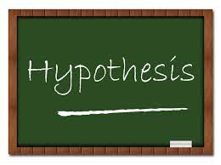
HYPOTHESIS TESTING | Listing out the Hypothesis formed for analyzing the data better and understanding the relation between various factors on sales
1
2
3
4

Slide 13
PRE-MODELING

Slide 14
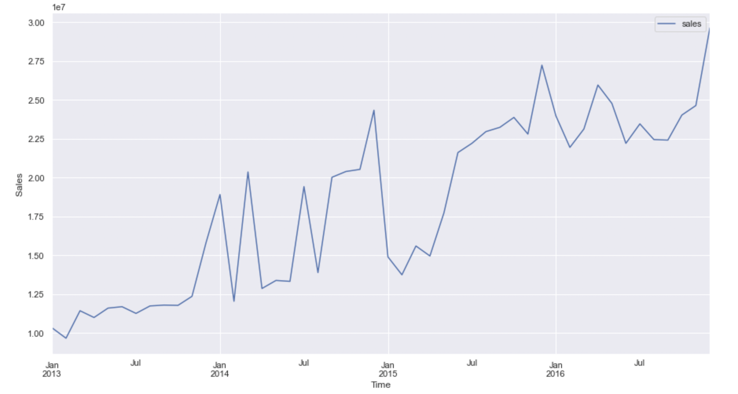
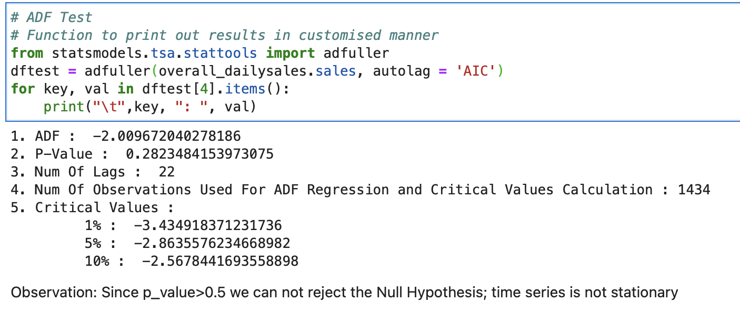
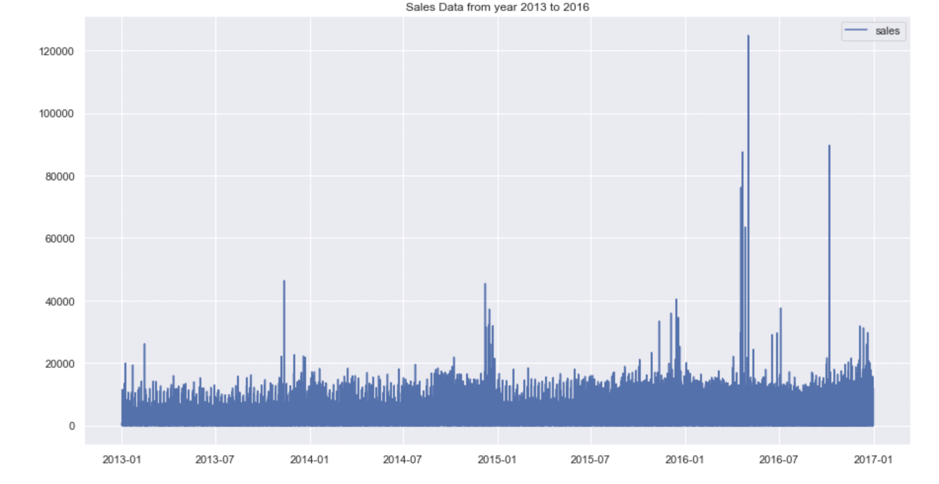
PRE- MODELING | Running ADF Test to check if the time series is stationary?
Observation:
Since p_value>0.05, we can conclude that our time series is not stationary.
To run any Time series model; we first need to make the series stationary
Observation:
As seen in the graph, we can clearly see an increasing trend along with spike in sales at a particular time period representing seasonality

Slide 15
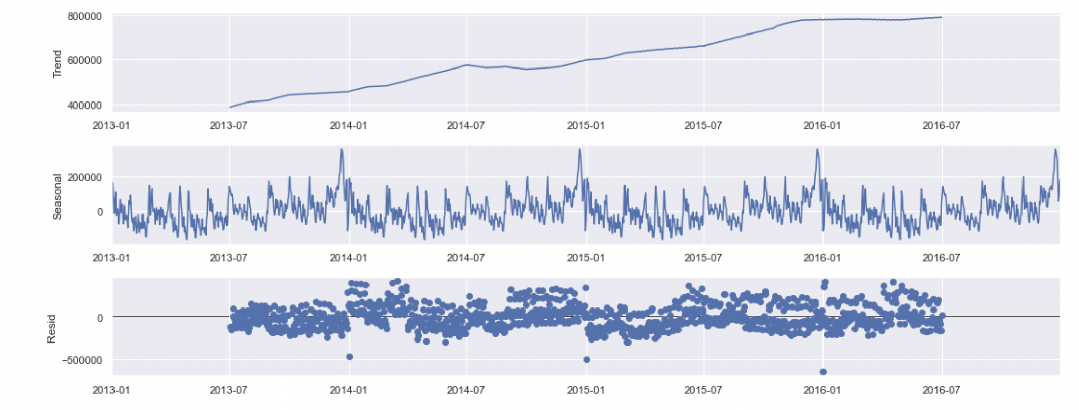
PRE- MODELING | Breaking down the time series to see the trend , seasonality and residual in our data
Observation:
Time series is an Additive one not a multiplicative one
Trend is present in the data along with Seasonality

Slide 16
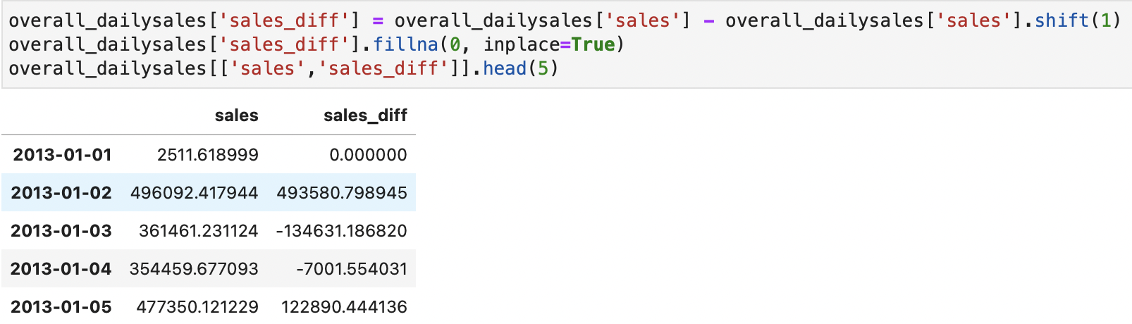
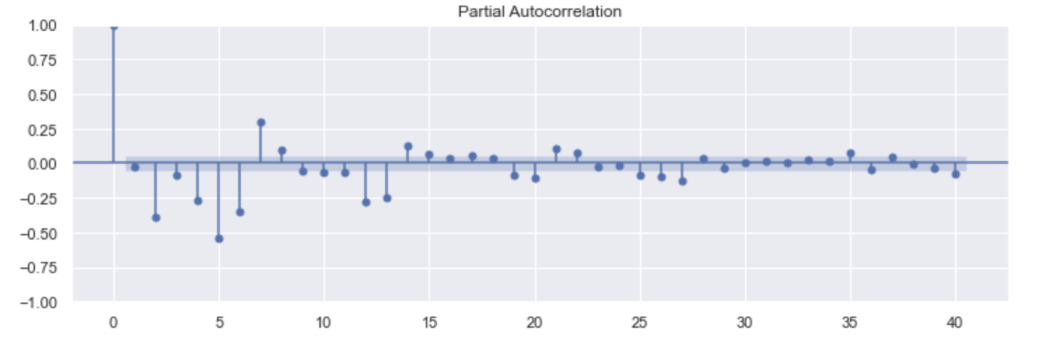
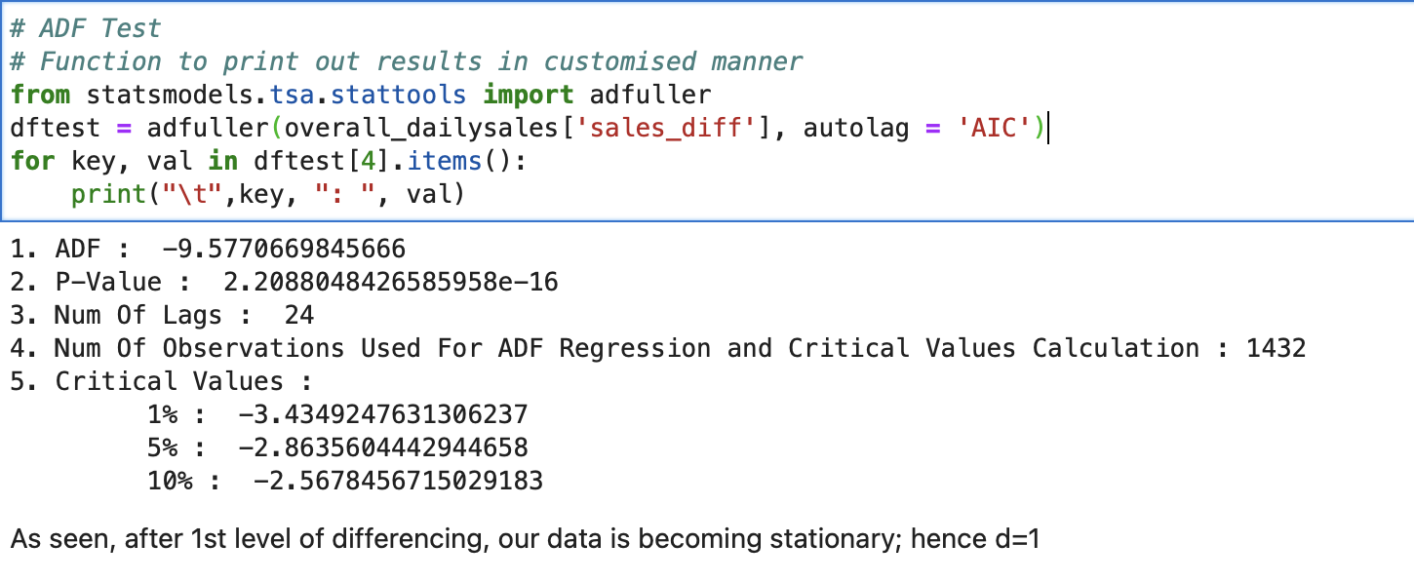
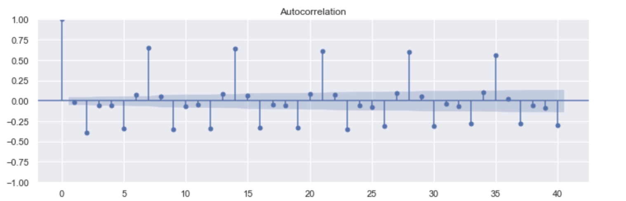
PRE- MODELING | Running ACF and PACF to find the P and Q value for the ARIMA Model along with doing first degree differencing to make our time series stationary
Observation:
We did first degree differencing to make our time series stationary for further forecasting. After doing the same, we again did ADF test to make sure our p value is coming less than 0.05; statistically
proving that timeseries is stationary now
Observation:
Time series is an Additive one not a multiplicative one
Trend is present in the data along with Seasonality

Slide 17
MODELING

Slide 18
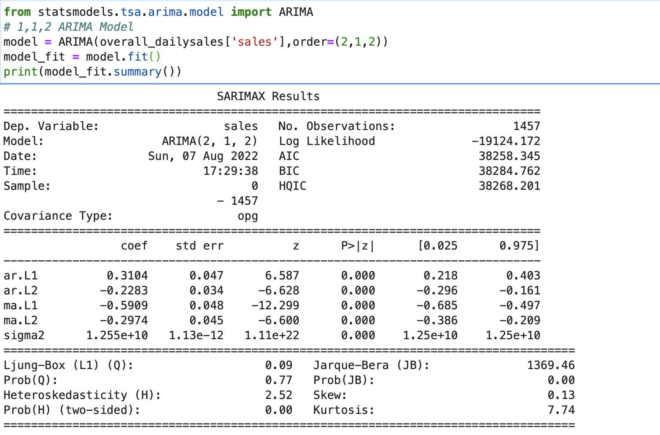
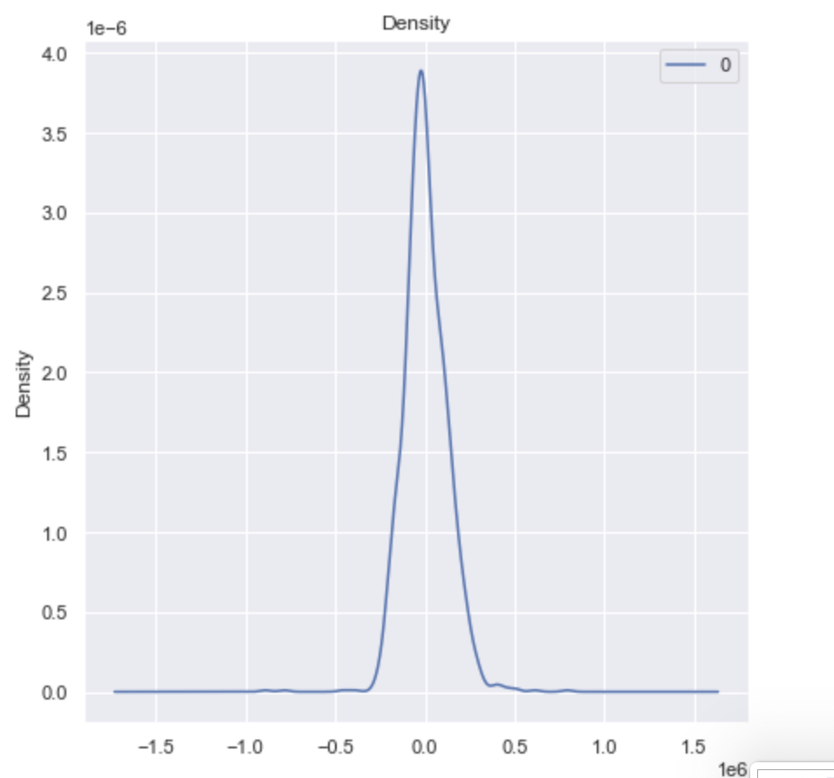
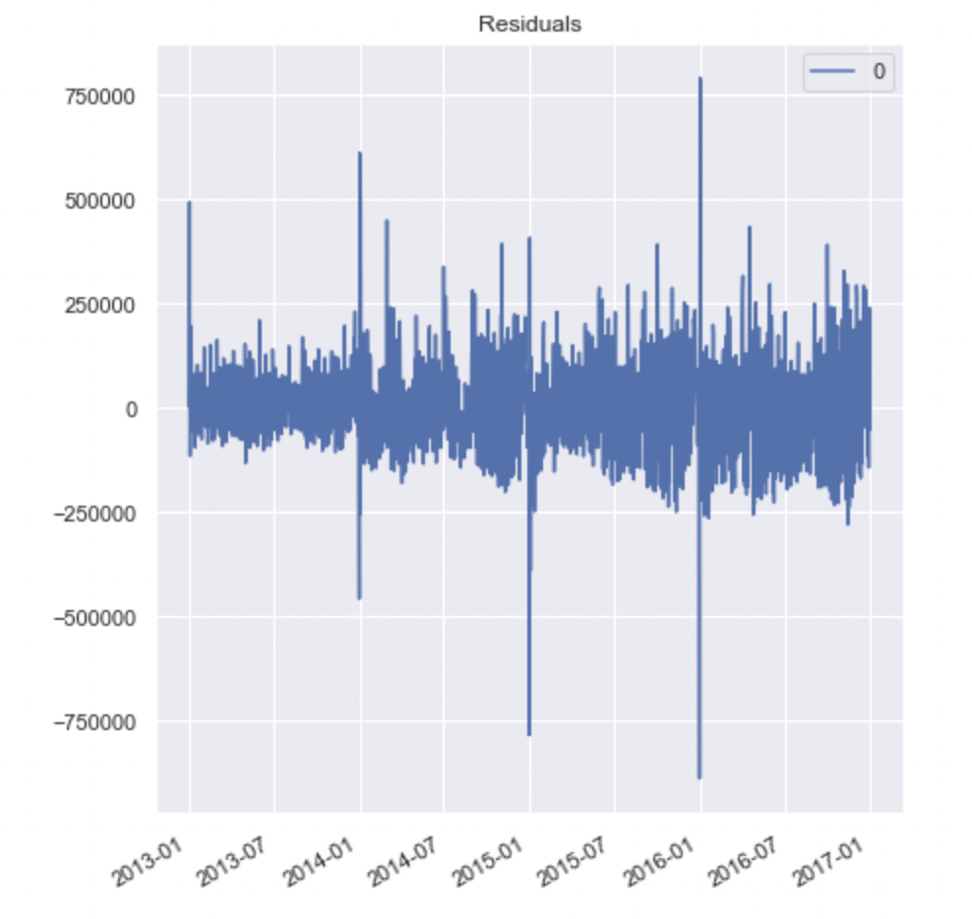
MODELING | TOTAL SALES | ARIMA
Observation:
We have used AR (p) =2, the number of lag observations or autoregressive terms in the model;
Integration (d)=1, the difference in the nonseasonal observations;
MA (q)=2, the size of the moving average window.
The residual errors seem fine with near zero mean and uniform variance.

Slide 19
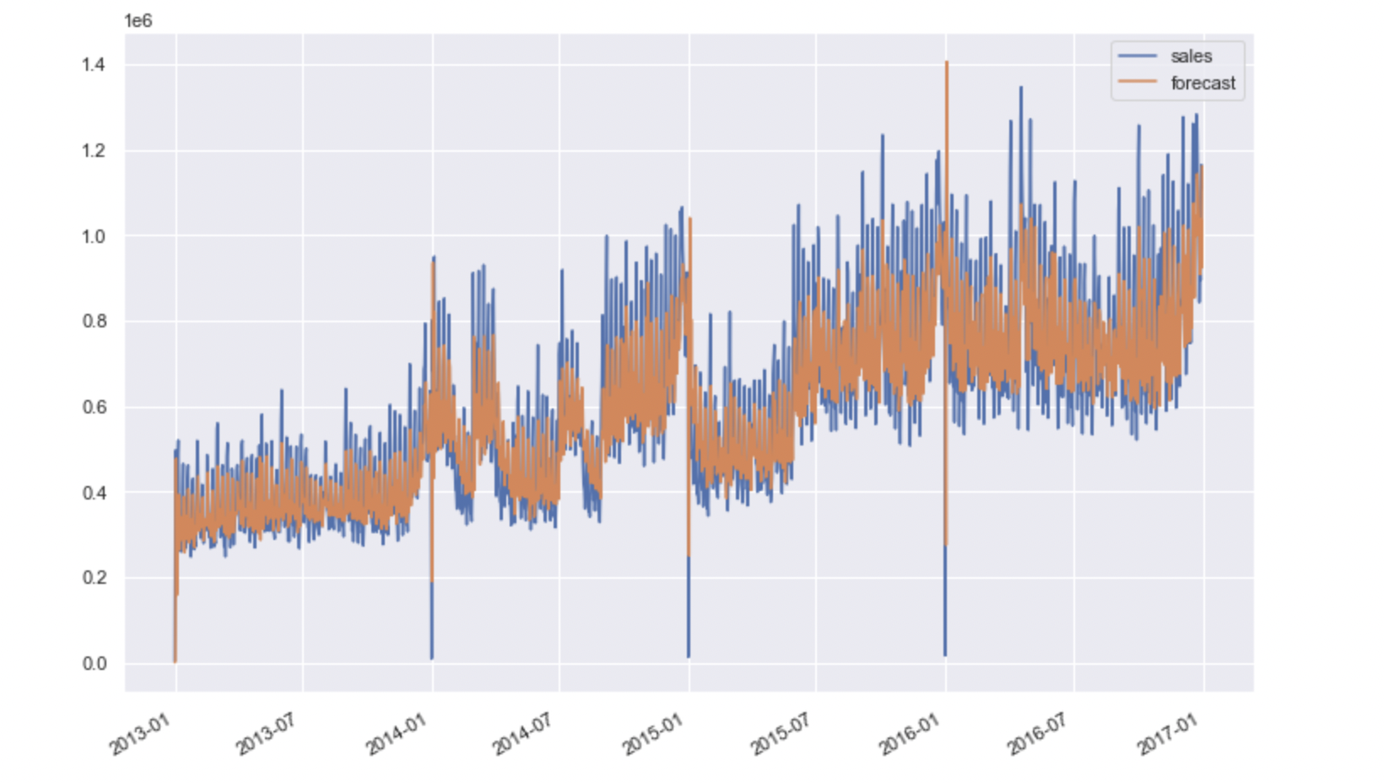
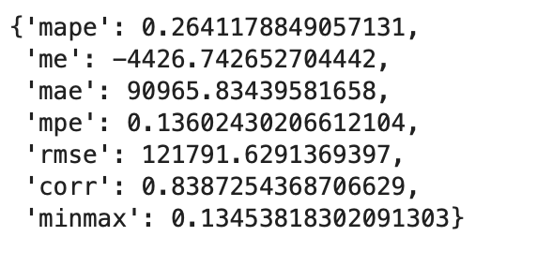
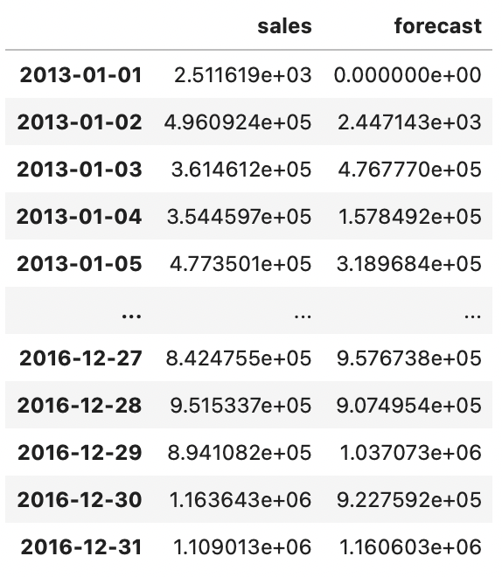
MODELING | TOTAL SALES | ARIMA
MAPE value is coming as 0.264 that is we are getting 74% accuracy in the forecasted values

Slide 20
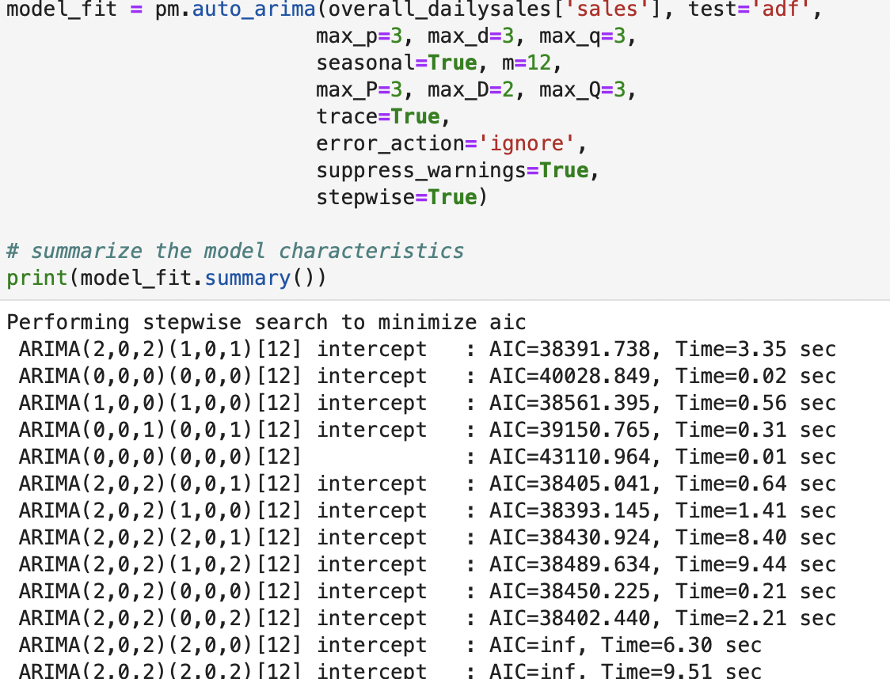
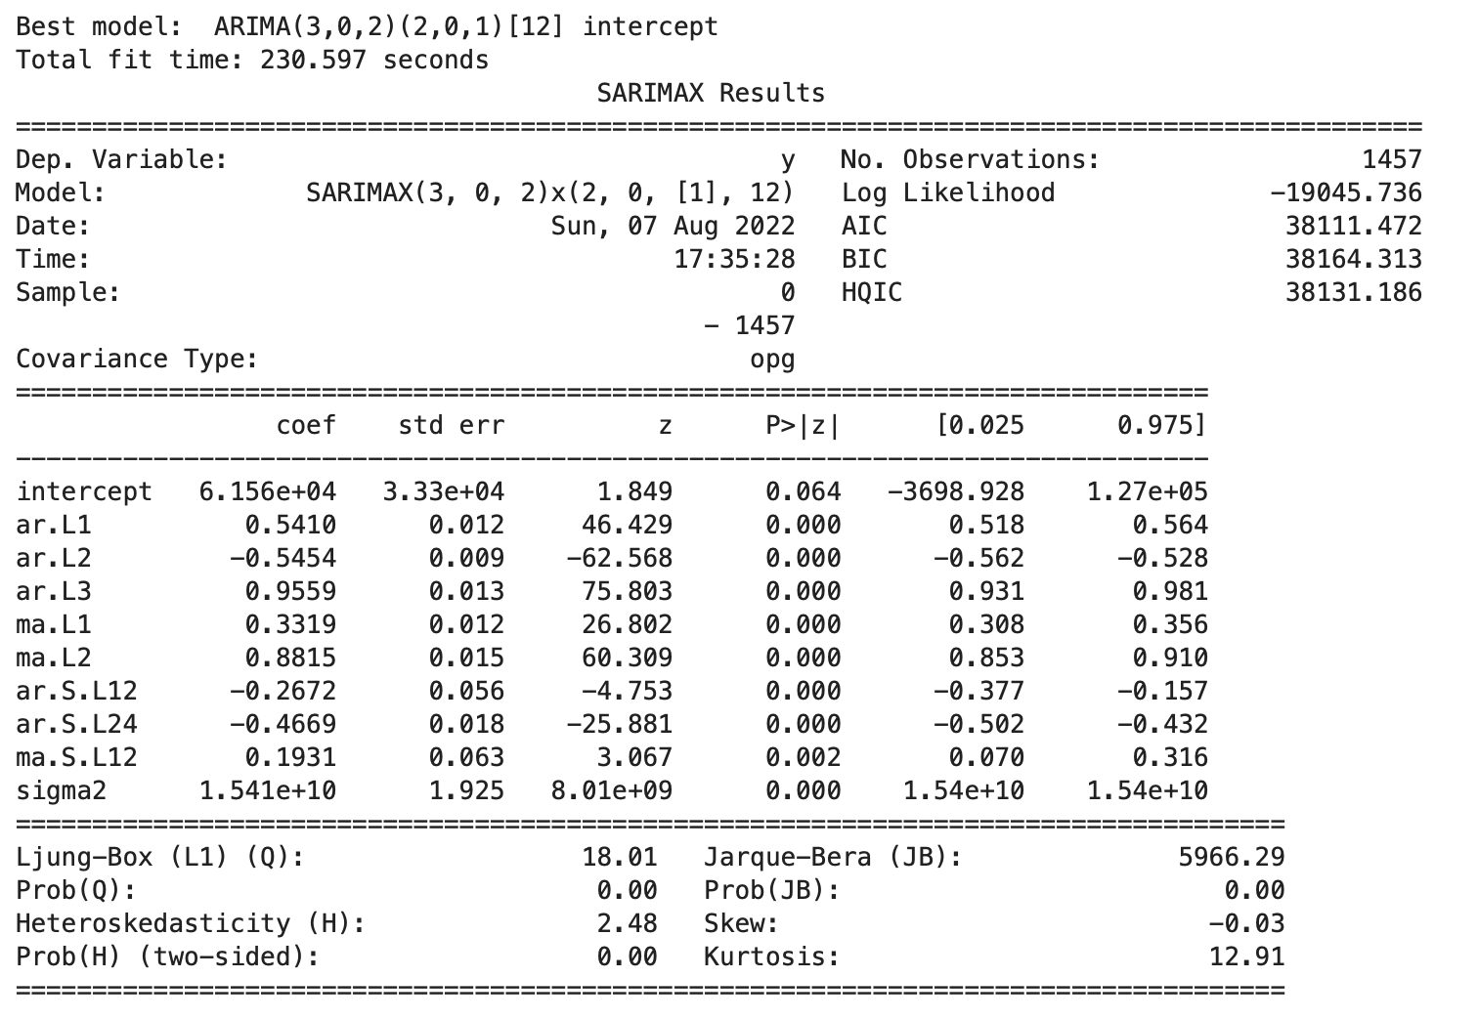
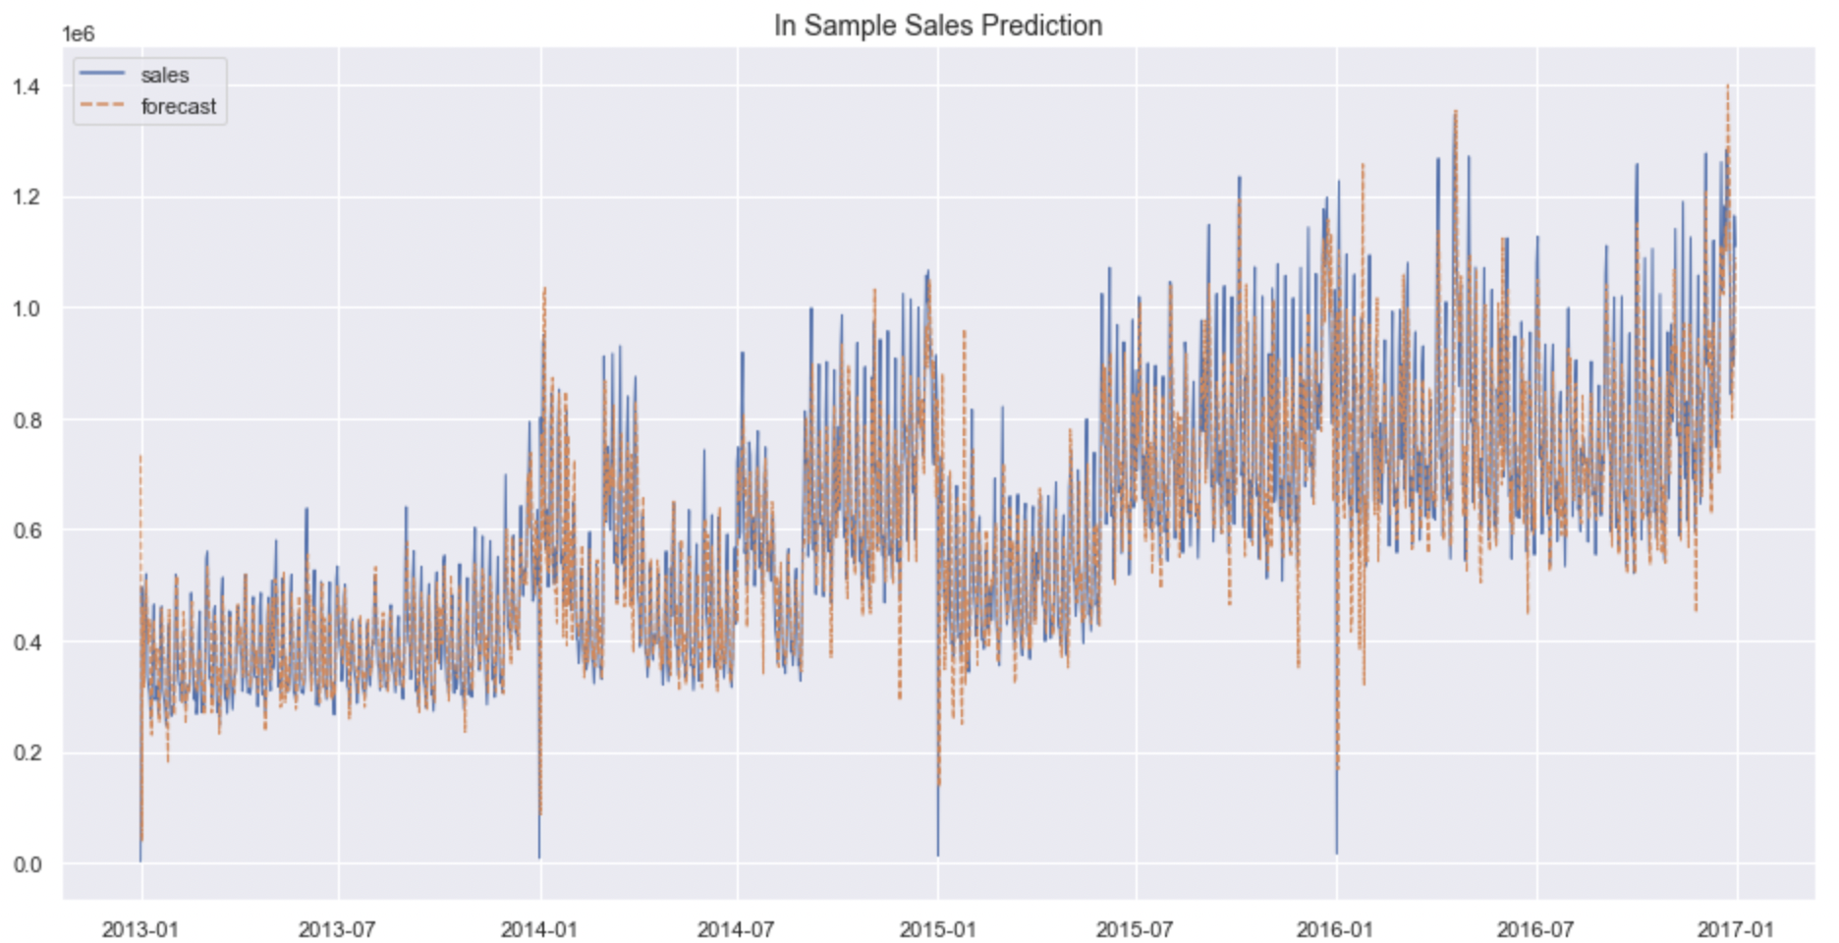
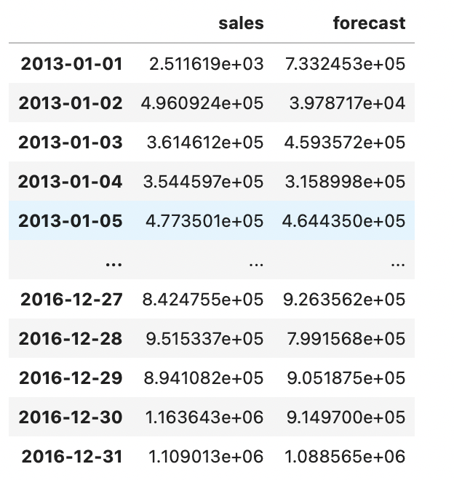
MODELING | TOTAL SALES | AUTO ARIMA
Observation:
We have run auto arima which automatically takes cares of AR(p), I(d), MA(q) value required for ARIMMA. It also incorporated the seasonality aspect of the data.

Slide 21
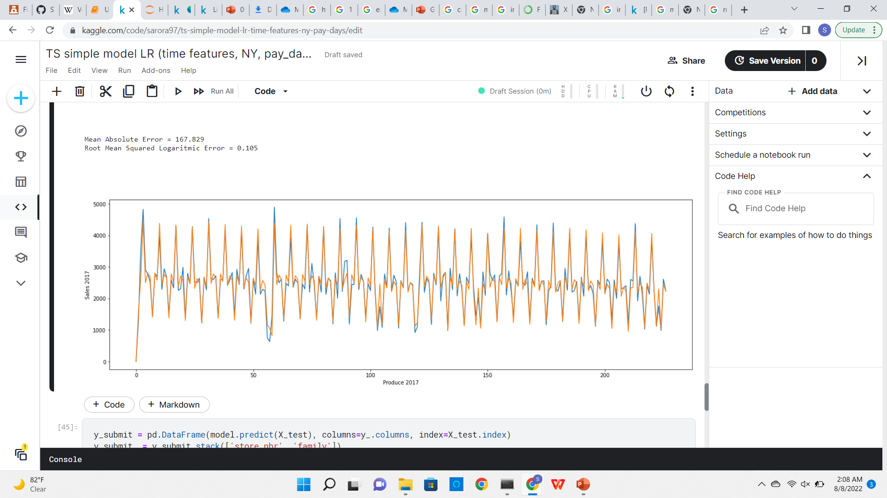
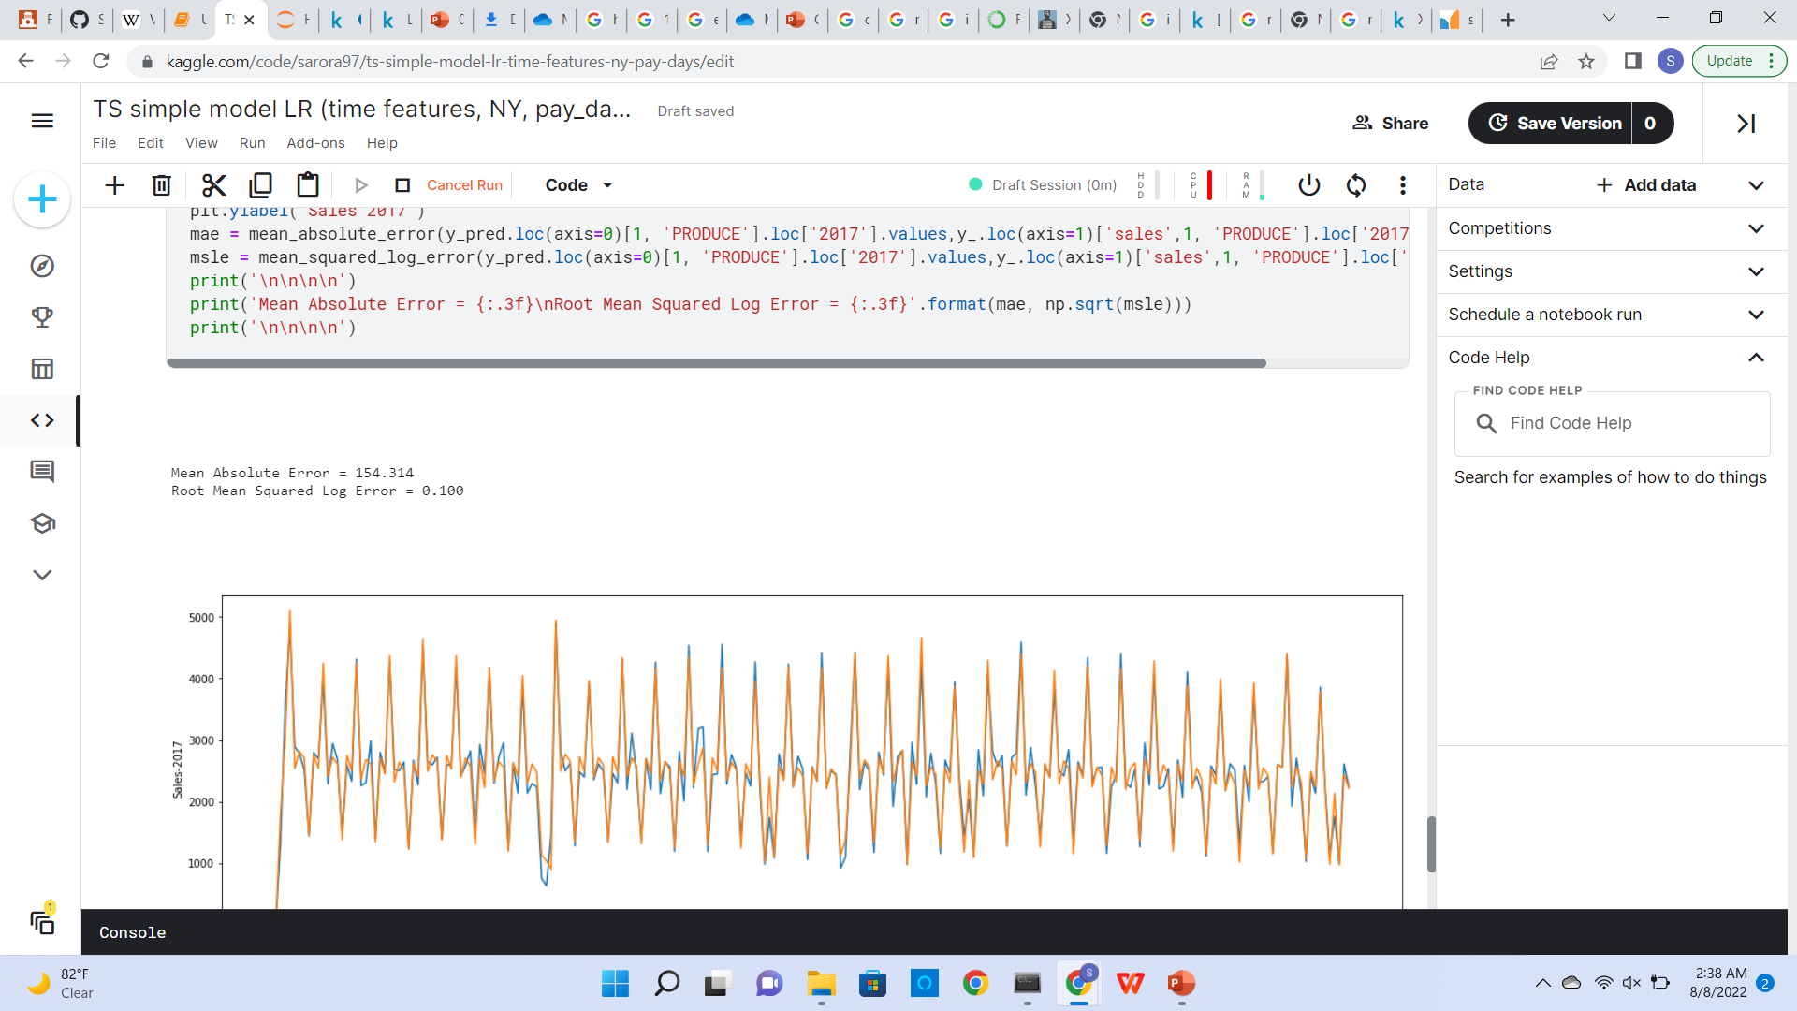
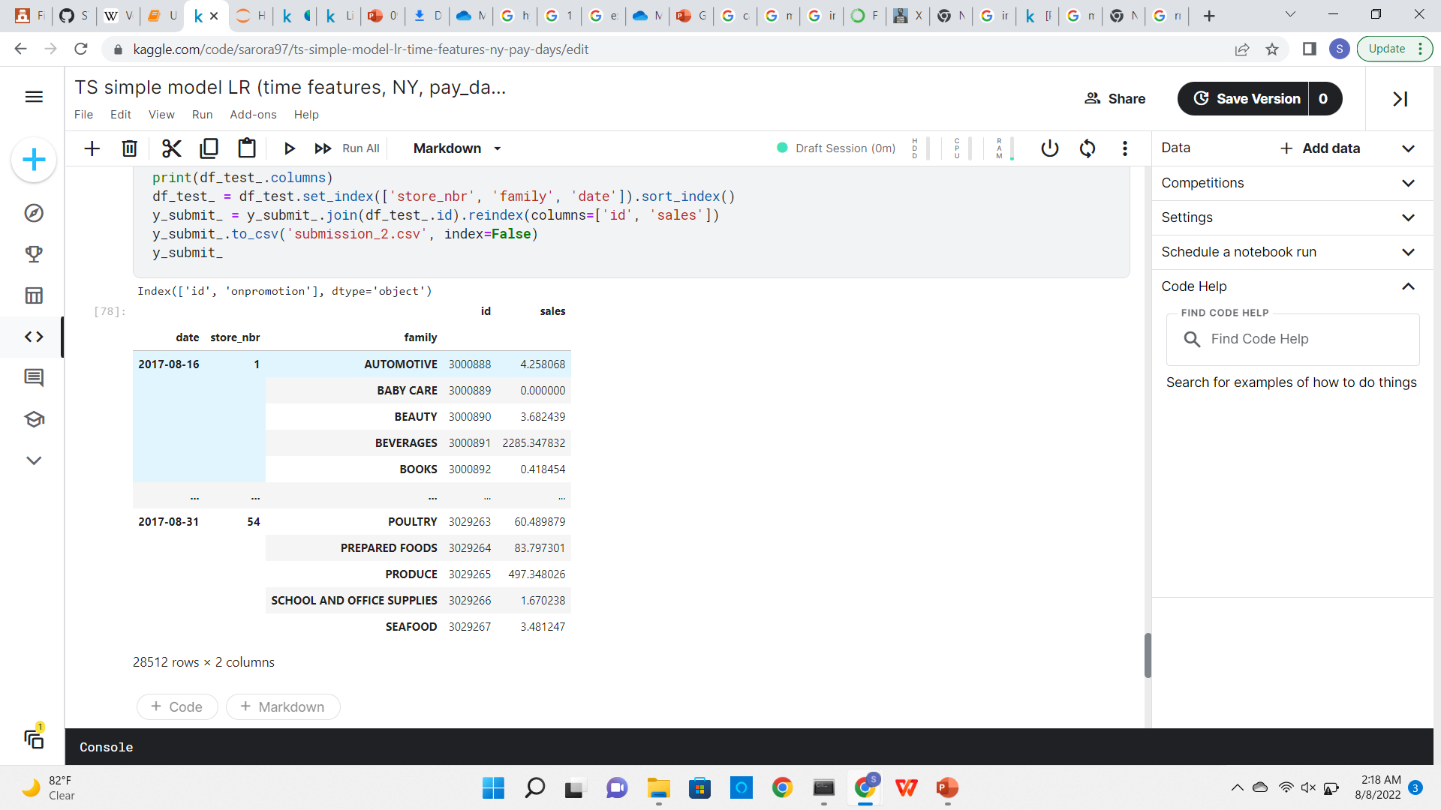
MODELING | XGBoost Regressor

Slide 22
THANK YOU

Slide 23
APPENDIX

Slide 24

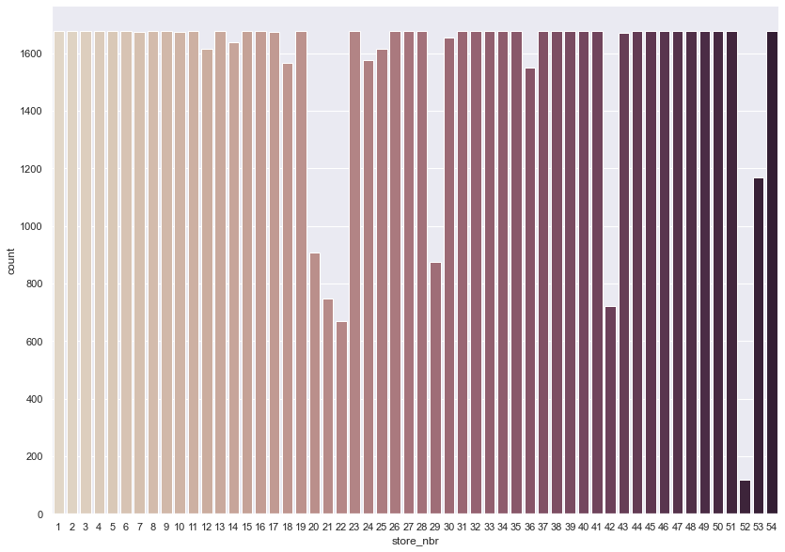
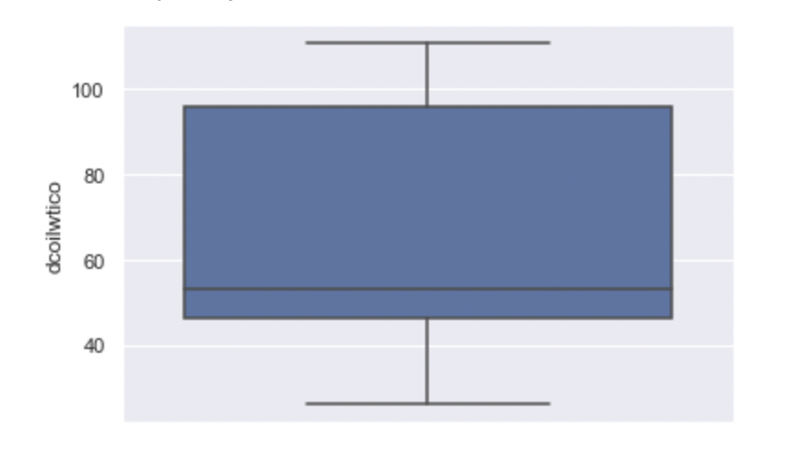
EDA | Uni-Variate Analysis | Transaction Data - Distribution of Stores across number of Transactions | OIL Data -

Slide 25
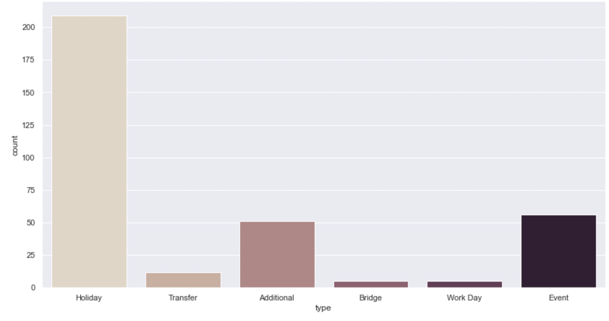
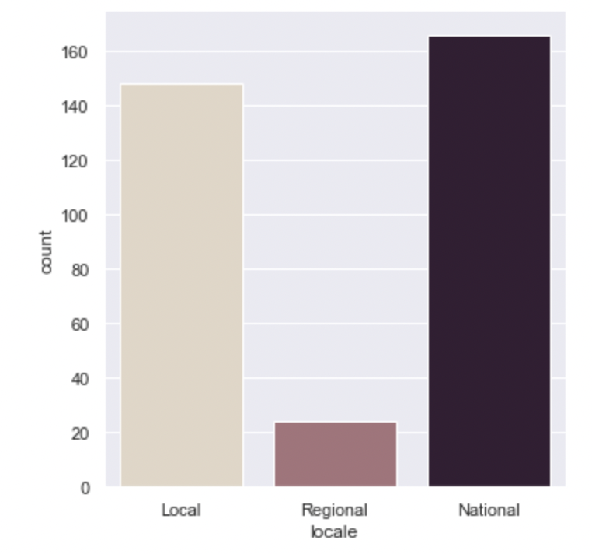
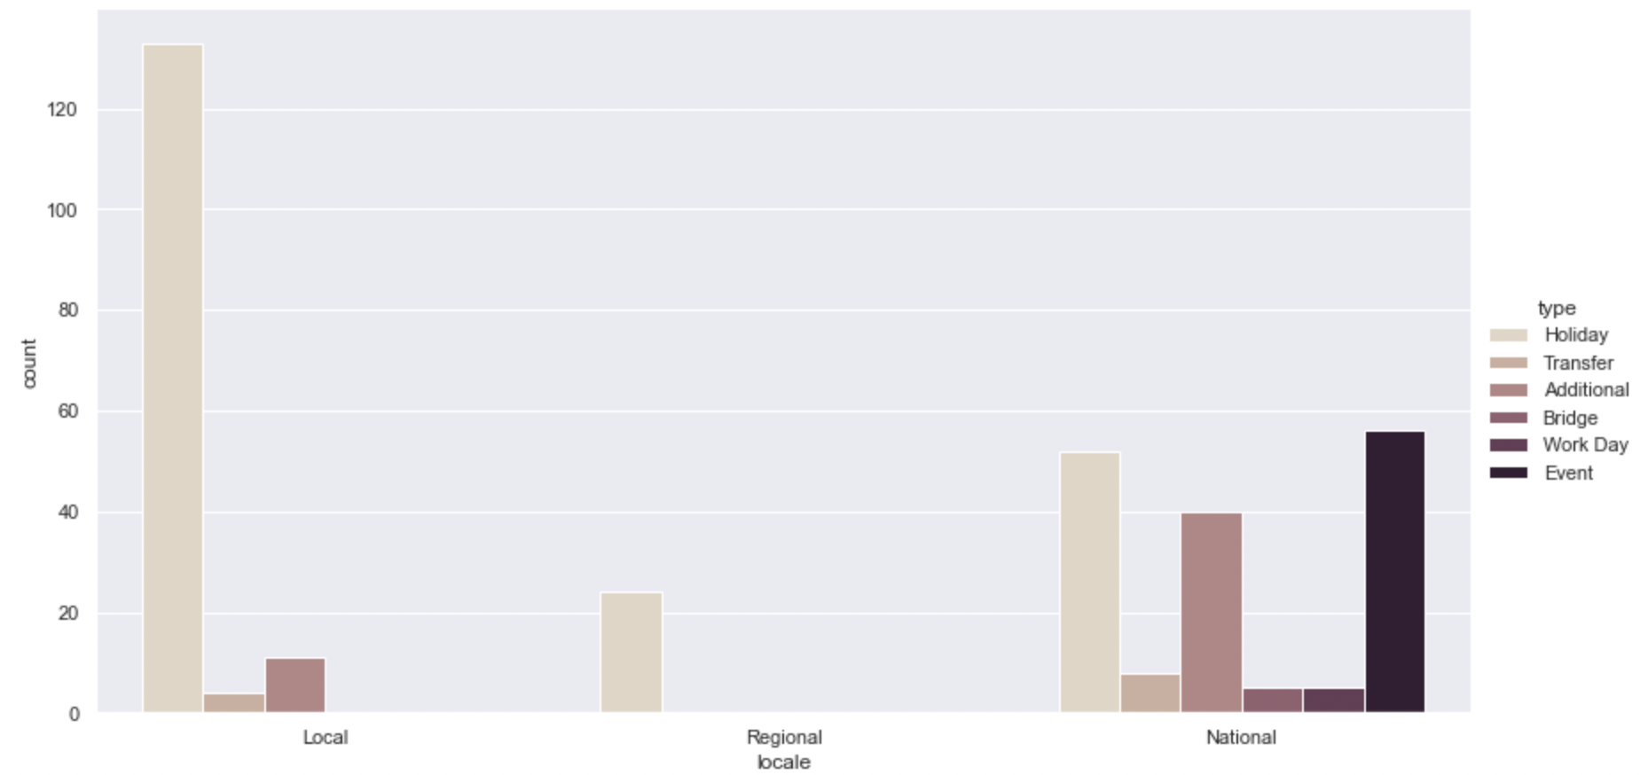
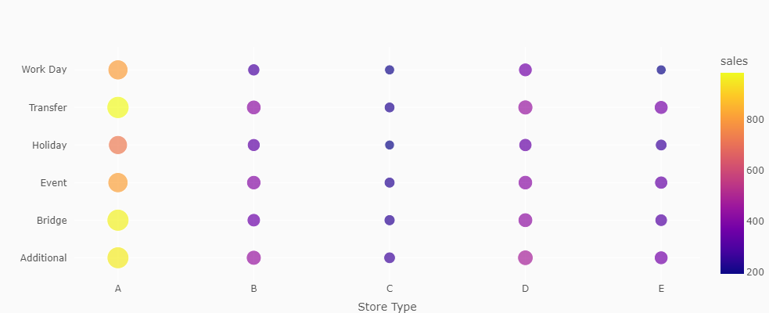
EDA | Uni-Variate Analysis | Holidays Data Frame – Distribution of Holiday Types

Slide 26
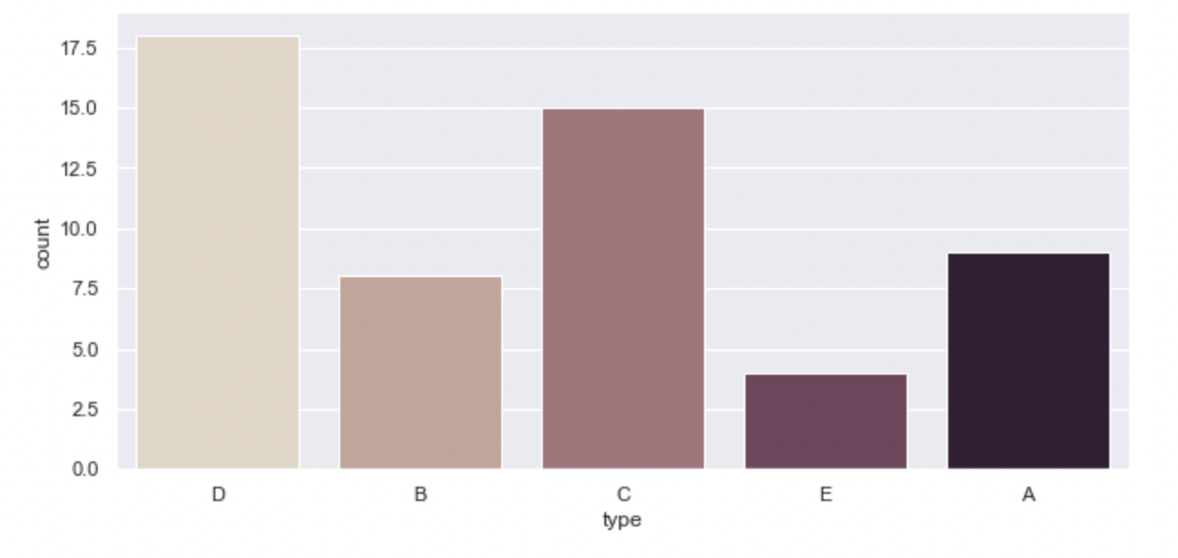
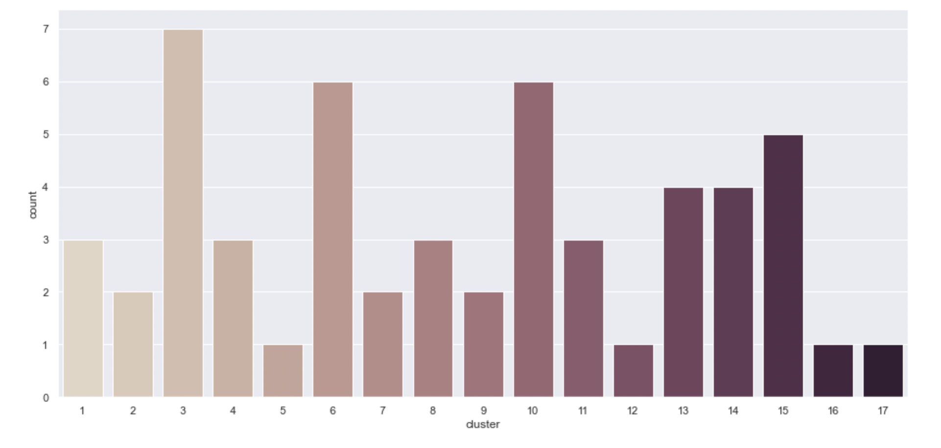
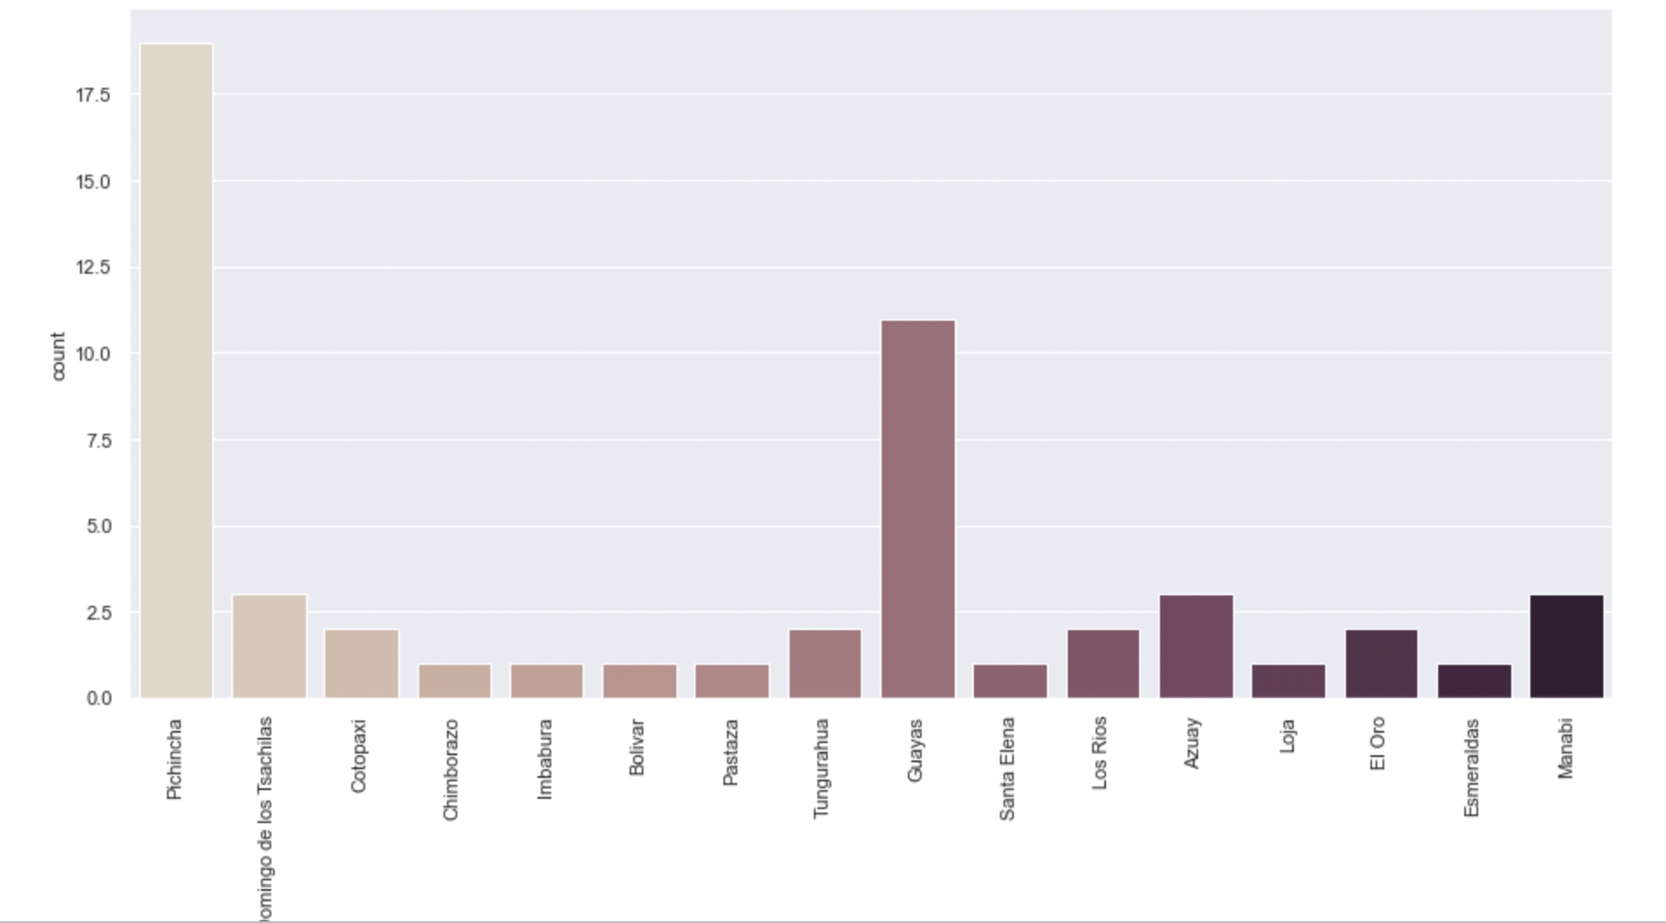
EDA | Uni-Variate Analysis | Checking the distribution of Store Type, Cluster and City in the Store Data Set

Slide 27
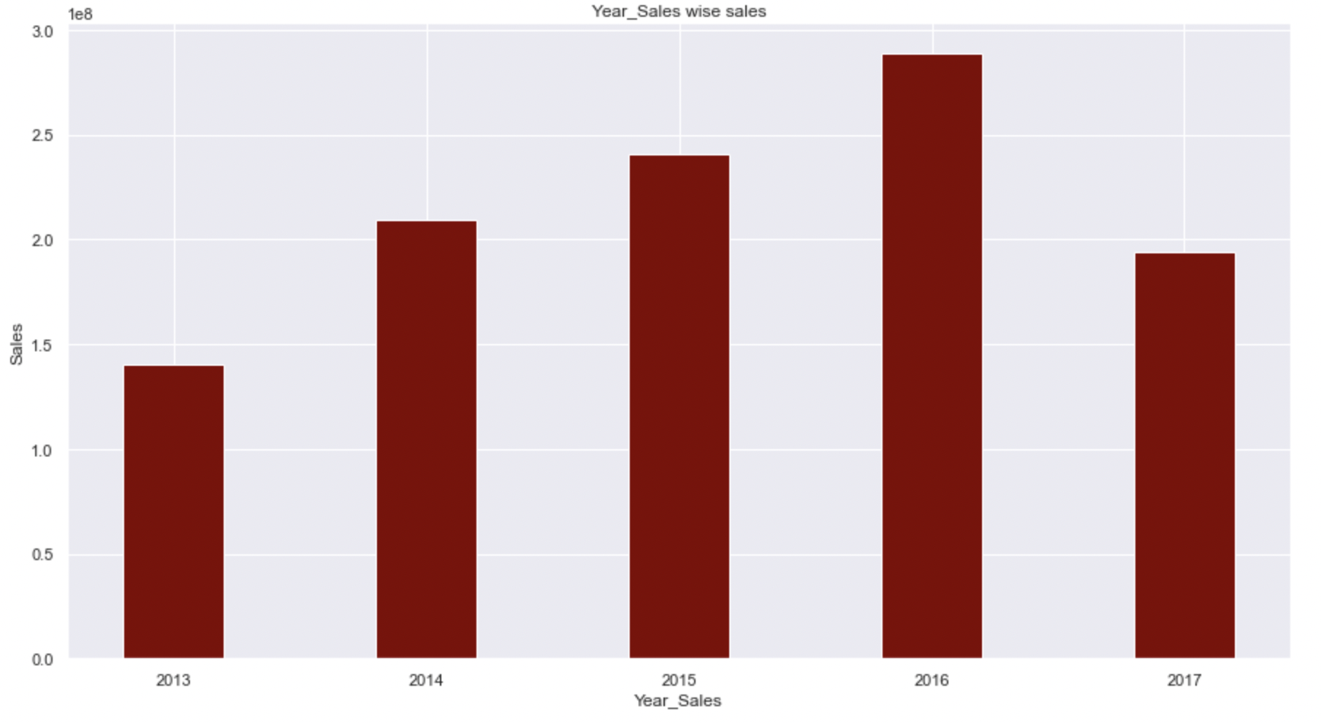
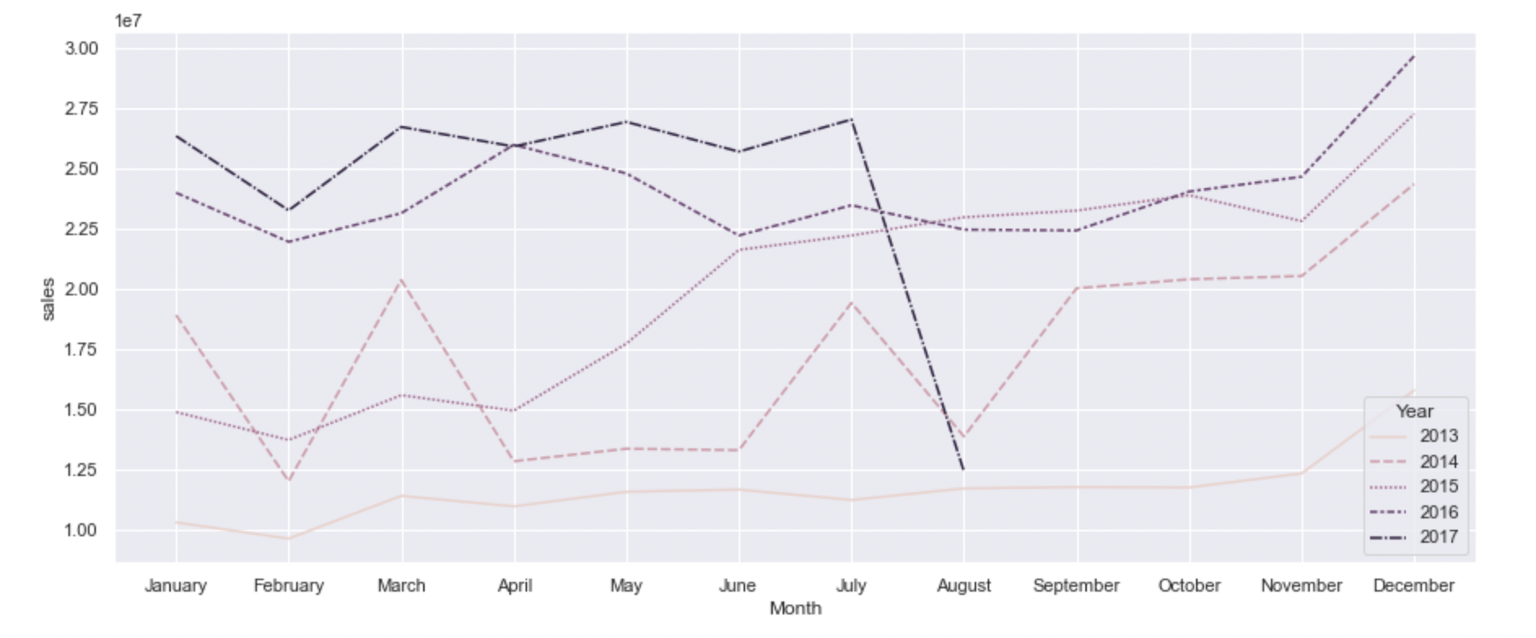
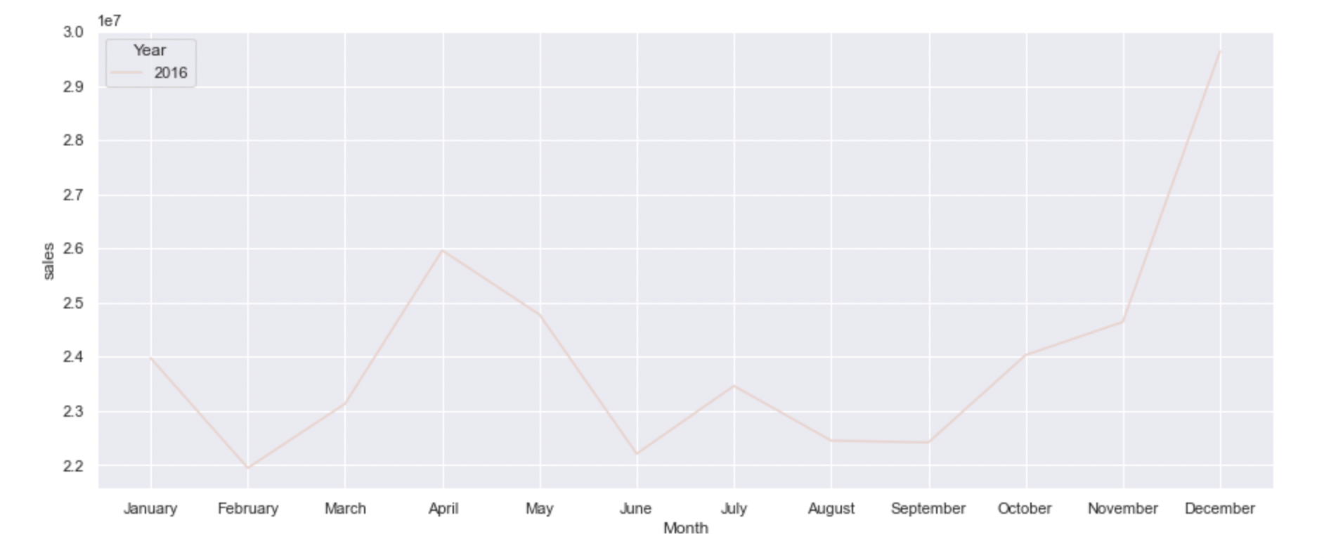
EDA | Plotting Sales across Years to determine if any seasonality or trend is present in the data
Observations:
a) Out of all five years, 2016 has the highest sales.
b) Further, we looked at monthly sales across all the 5 years to check if all the year has the same trend across the month
c) We found that there is uncommon spike in sales in the month of April for the year of 2016. As it has been mentioned that an earthquake happened, this could be a reason for the spike of sales

Slide 28
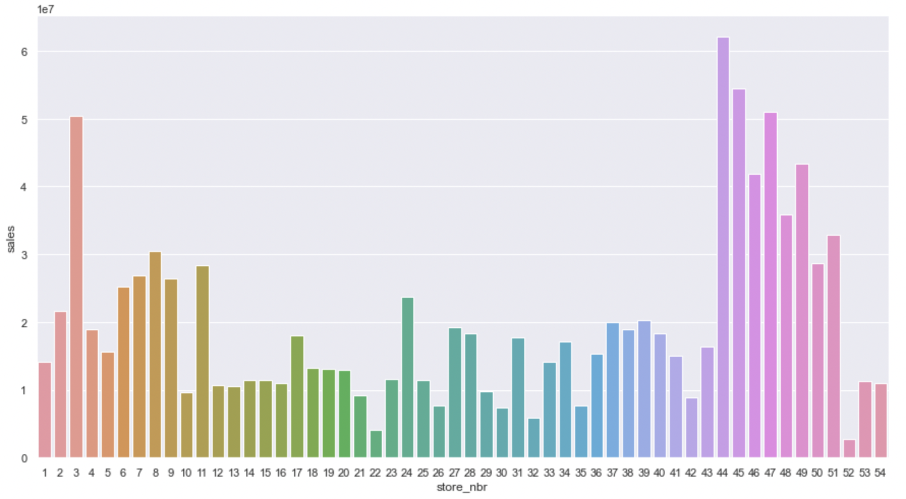
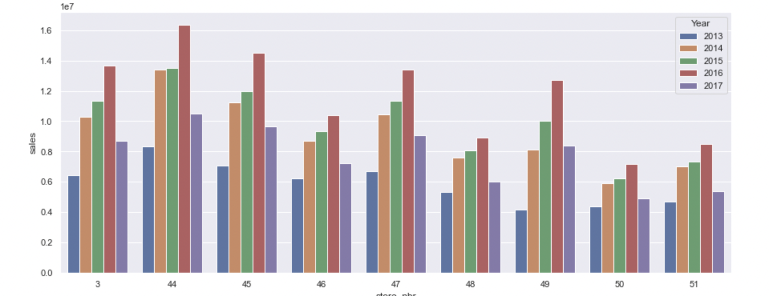
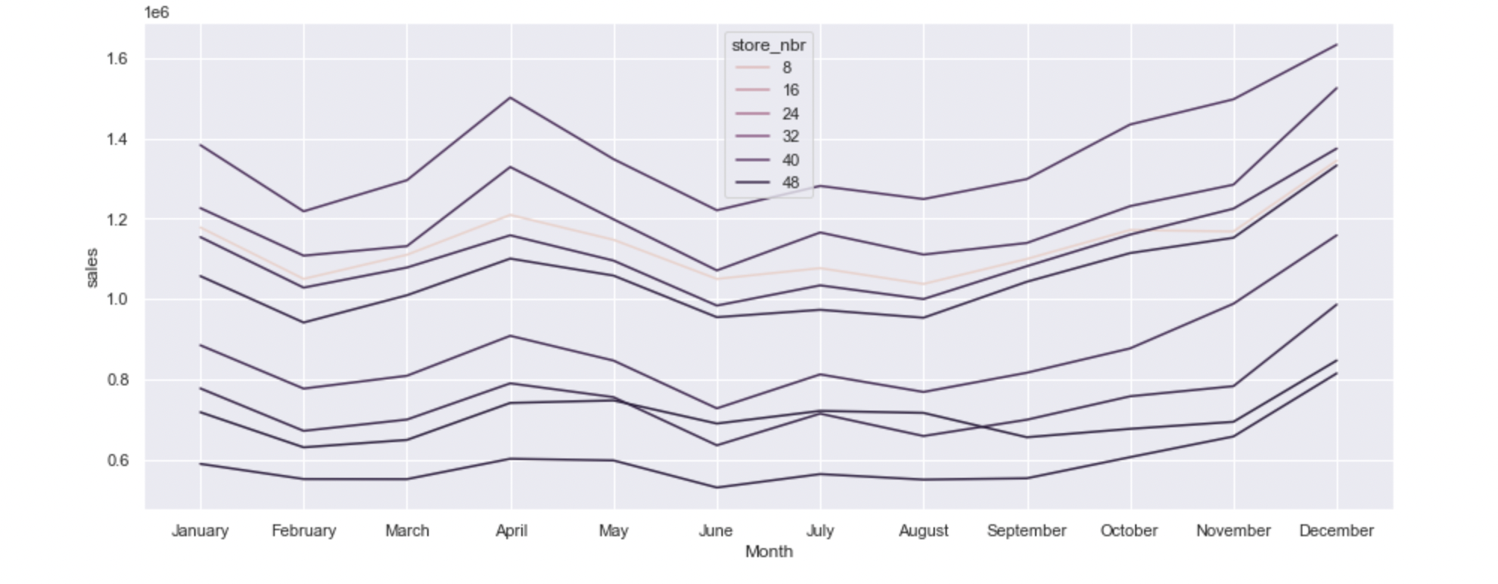
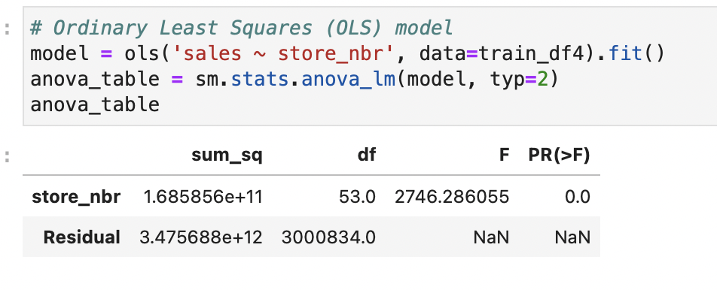
HYPOTHESIS TESTING | Hypothesis #1| Store has an effect on Sales of the company H0: Store has no effect on sales | H1: Store has an effect on sales
As P<0.05, we can reject the Null Hypothesis; i.e. Store Number has an effect on sales.
All the stores have pretty much similar sales except Store- 3,44,45,46,47,48,49,50,51. We looked deeper into them
These stores have a spike in sales in the year of 2016 approximately by 25% in most of the stores; one of the main reason could be the earthquake in April 2016.

Slide 29
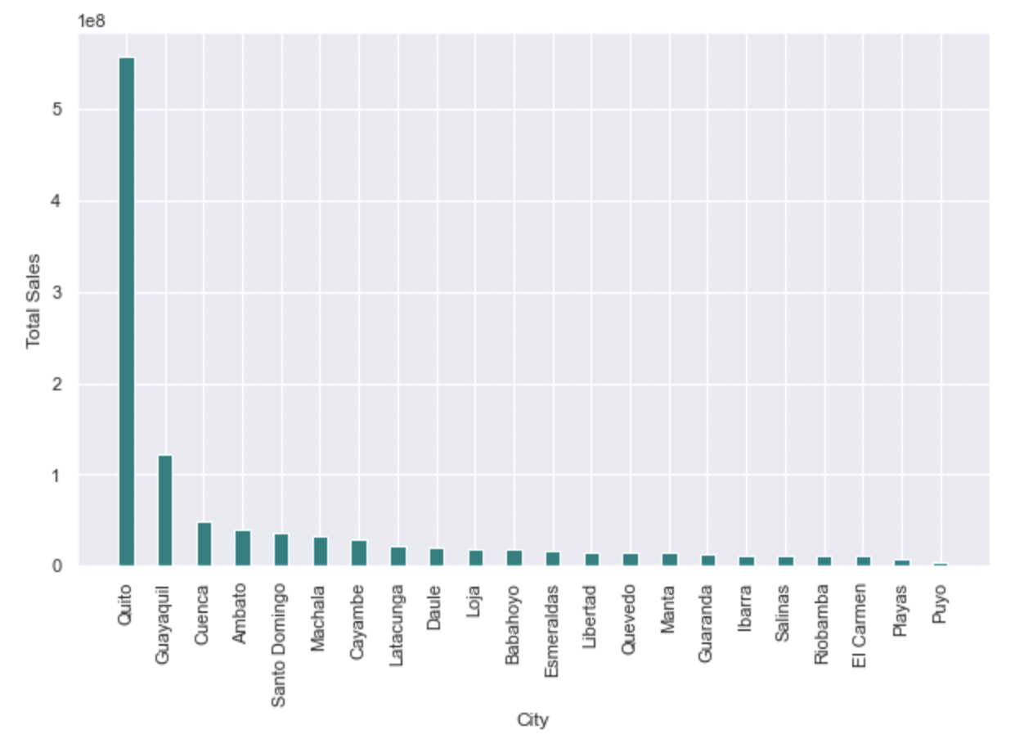
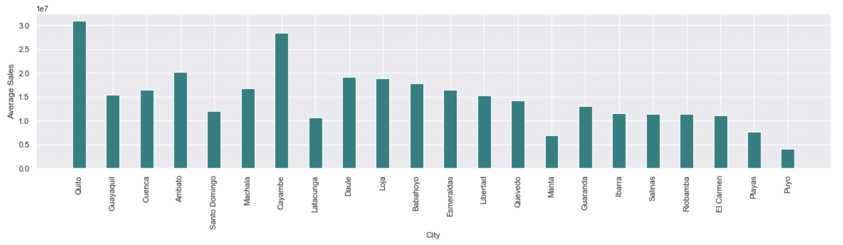
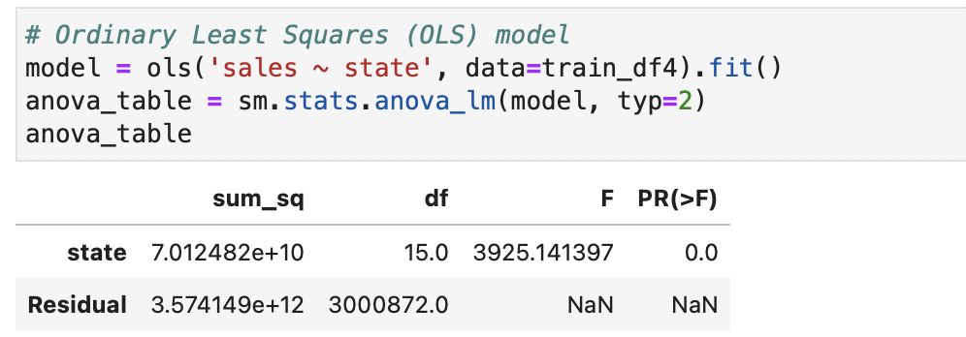
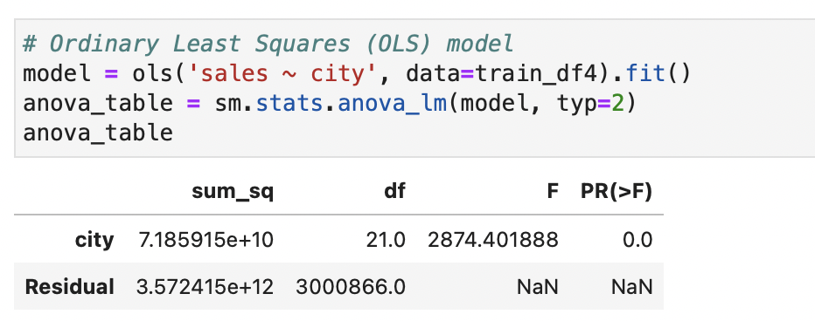
HYPOTHESIS TESTING | Hypothesis #2 | Location has an effect on Sales of the company
H0: Location has no effect on sales | H1: Location has an effect on sales
As seen from the graph, Total sales and average sales per store are highest in City Quito, followed by Guayaquil
As P<0.05, we can reject the Null Hypothesis; i.e. City / State has an effect on sales

Slide 30
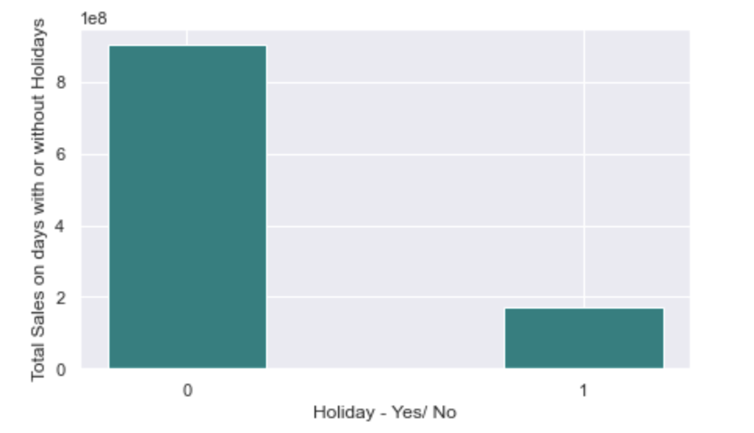
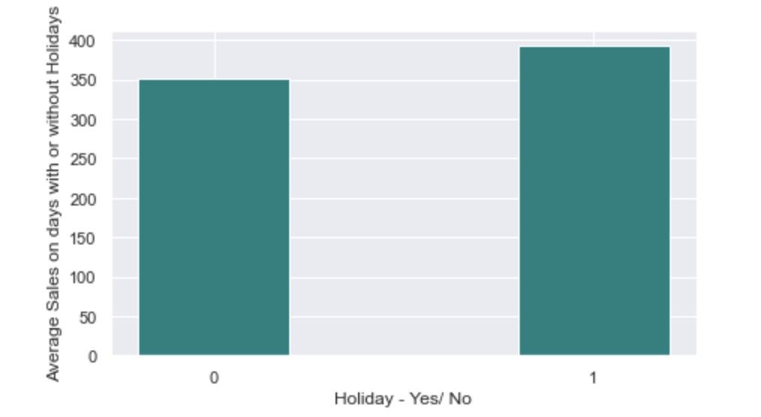
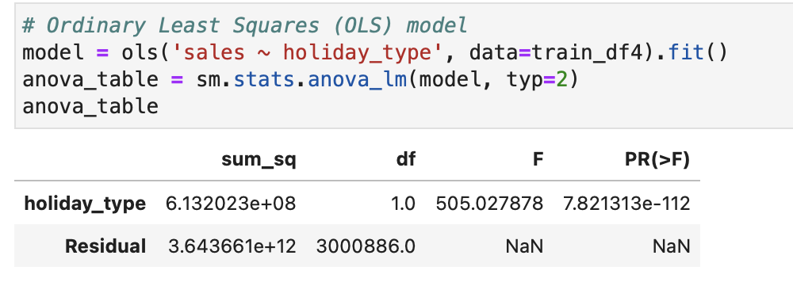
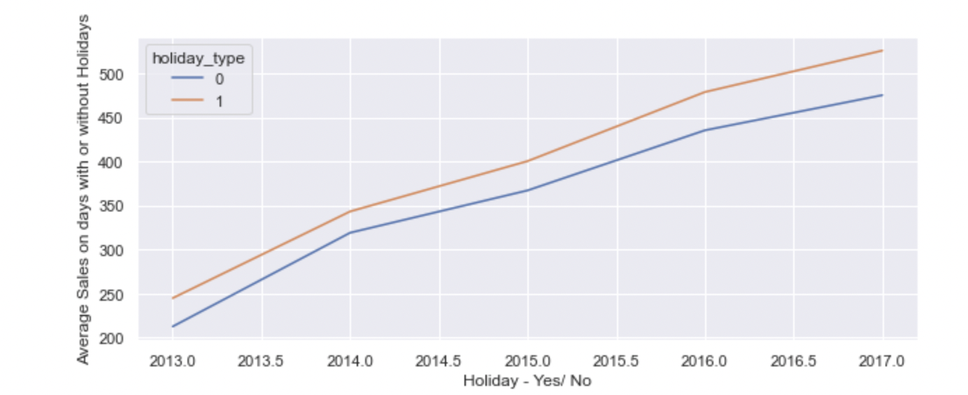
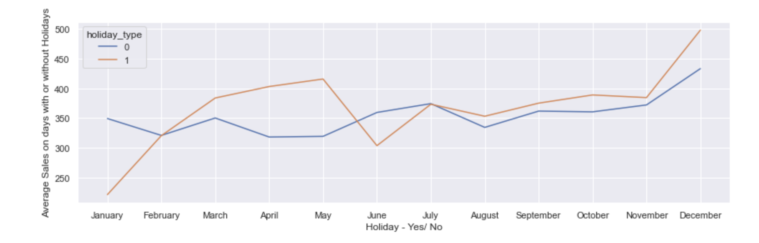
HYPOTHESIS TESTING | Hypothesis #3 | Holiday has an effect on Sales of the company H0: Holiday has no effect on sales | H1: Holiday has an effect on sales
As P<0.05, we can reject the Null Hypothesis; i.e. Holiday has an effect on sales
Observations:
Even though total sales on days without holiday is far greater than days with holiday; if we look into average sales; it is just the opposite;
Conclusion:
Sales are much higher on Holidays than without Holidays

Slide 31
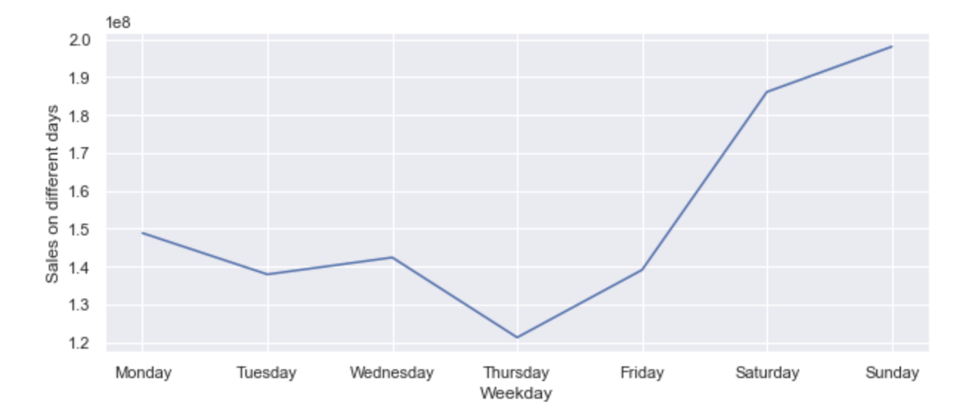
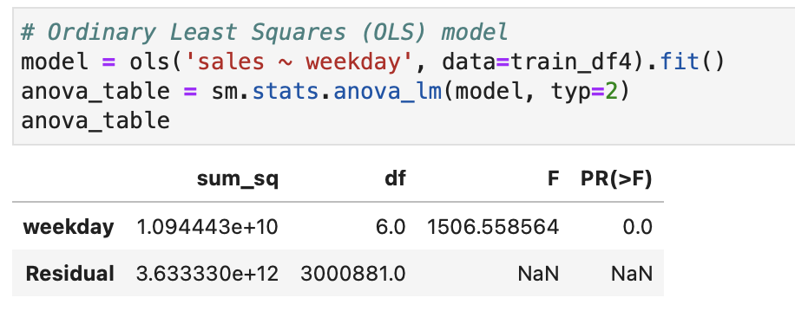
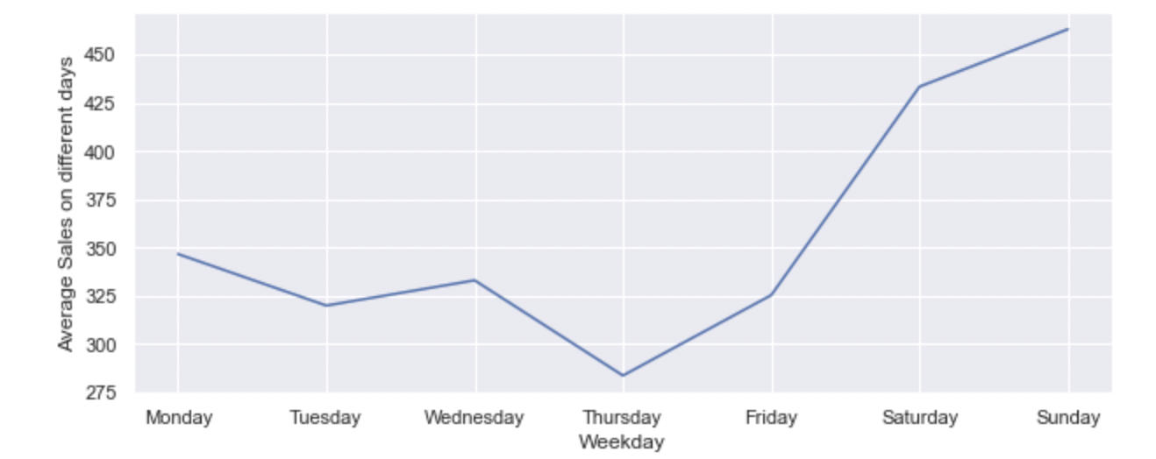
HYPOTHESIS TESTING | Hypothesis #4 | Weekday has an effect on Sales of the company H0: Weekday has no effect on sales | H1: Weekday has an effect on sales
As P<0.05, we can reject the Null Hypothesis; i.e. Weekday has an effect on sales
Observations:
Total sales on weekends is far greater than that of weekdays; if we look into average sales; the same trend continues;
Conclusion:
People tend to shop more during Weekends

